Slide 1
Unit 3 MULTIPLYING POLYNOMIALS
Algebra 1

Slide 2
DISTRIBUTIVE PROPERTY
$${3x}^{3}{(8x}^{5}+ {5x}^{2})$$
$${−2x}^{8}{(−4x}^{3}− {2x}^{7})$$

Slide 3
FOIL
$(A+B)(C+D$ $)$
$$(2x+5)(3x+9)$$
$(A+B)(C+D$ $)$
F: FIRST
O: OUTSIDE
I: INSIDE
L: LAST
$(A+B)(C+D$ $)$
$(A+B)(C+D$ $)$
$(A+B)(C+D$ $)$

Slide 4
FOIL
$(A+B)(C+D$ $)$
$$(5x−3)(10x−1)$$
$(A+B)(C+D$ $)$
F: FIRST
O: OUTSIDE
I: INSIDE
L: LAST
$(A+B)(C+D$ $)$
$(A+B)(C+D$ $)$
$(A+B)(C+D$ $)$

Slide 5
FIND THE SQUARE
$${(8m−4)}^{2}$$
$${(3m+7)}^{2}$$

Slide 6
BINOMIAL TIMES A TRINOMIAL
$${(2p+1)(p}^{2}−3p+4)$$

Slide 7
BINOMIAL TIMES A TRINOMIAL
$${(2x^{2}−3)(5x}^{3}−4x+8)$$

Slide 8
BINOMIAL TIMES A TRINOMIAL
$${(x}^{2}−5x+4)(2x−5)$$

Slide 9
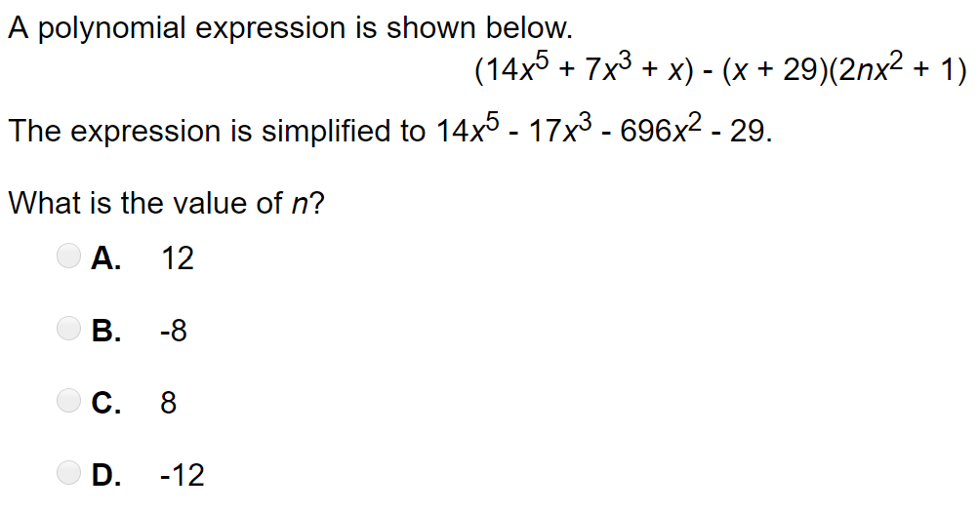
Word Problem

Slide 10
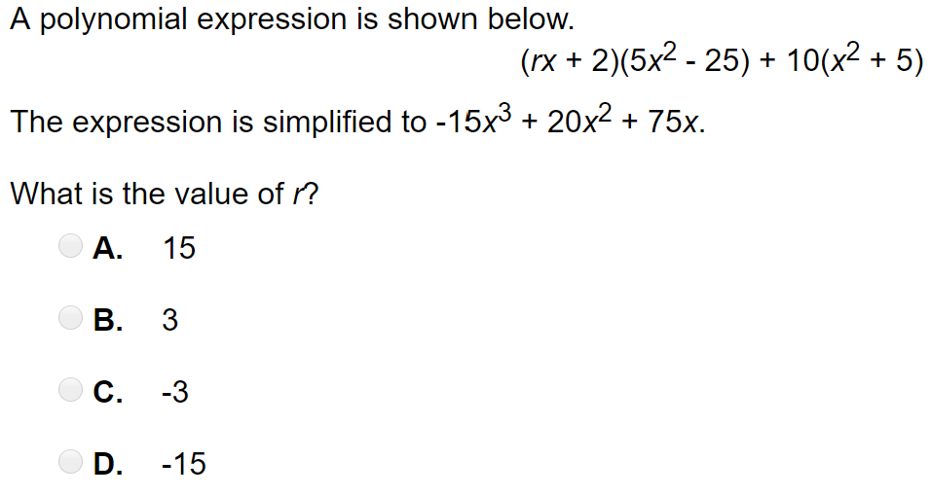
Word Problem

Slide 11
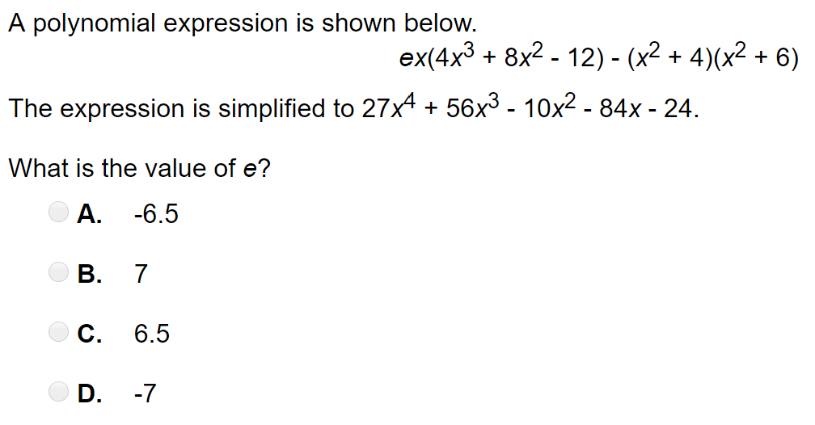
Word Problem

